Slide 1
MASCULINTY
#METOO
Jamila Holt
Data Scientist

Slide 2
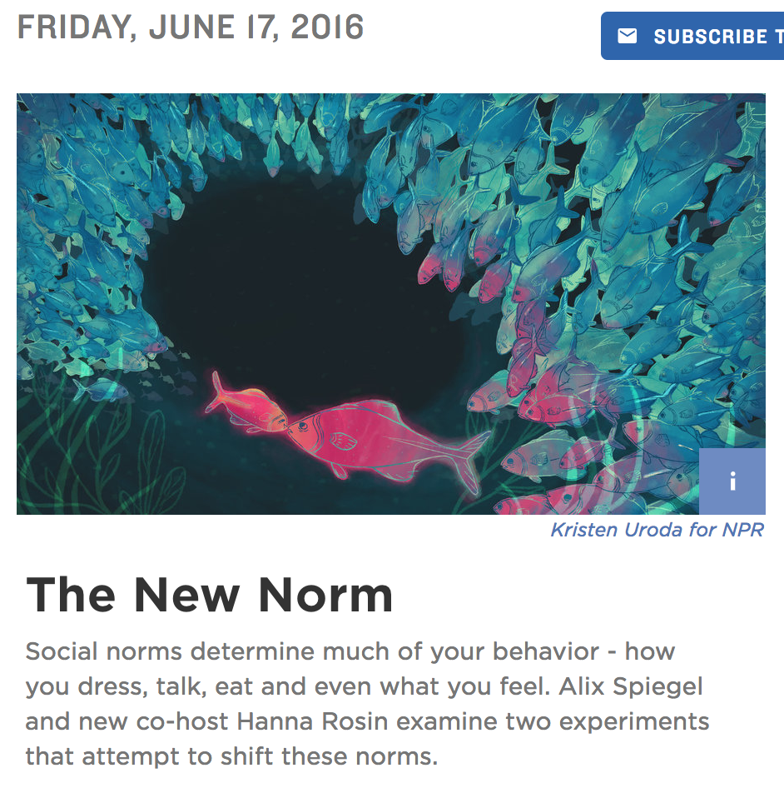
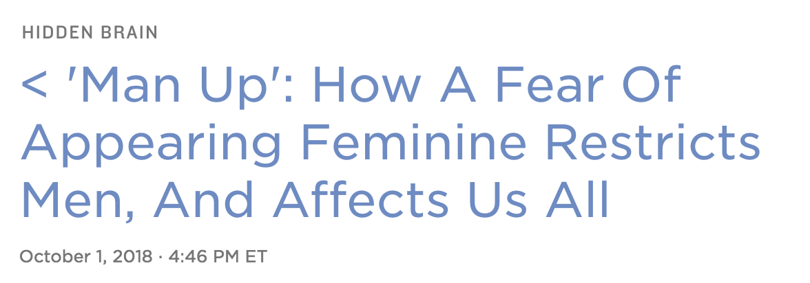
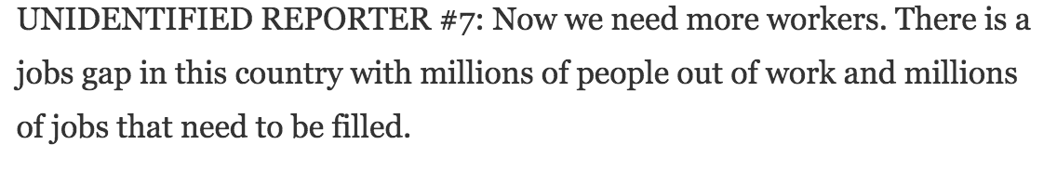
Masculinity

Slide 3
200 Men and women wrote about a time they violated their gender role in public
“Some of the women talked about being called a tomboy. Others mentioned times when they worked in male-dominated fields and were made to feel uncomfortable by co-workers. But men?”
“Men say things like, I wore a pink shirt to work, or I held my girlfriend's purse while she ran into the bank, or I ordered a drink at a restaurant and when it came out to me, it had a little cocktail umbrella in it, and my, you know, my friends teased me. So it's like - it's just mundane things.”
“Like women don't say, oh, I wore the wrong shirt.”

Slide 4
the problem Statement
Has the #metoo movement affected men?
Goal:
Use masculinity features to predict men’s behavioral response to their exposure to the #metoo movement.

Slide 5

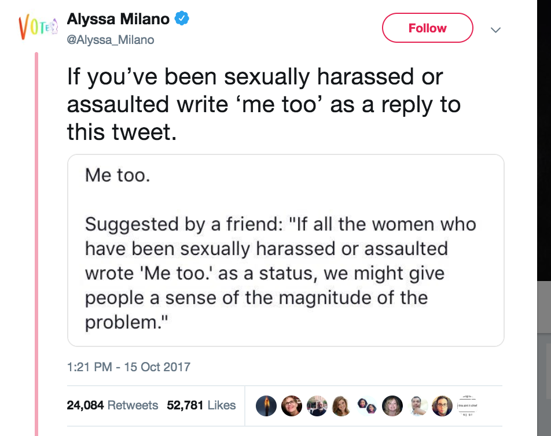
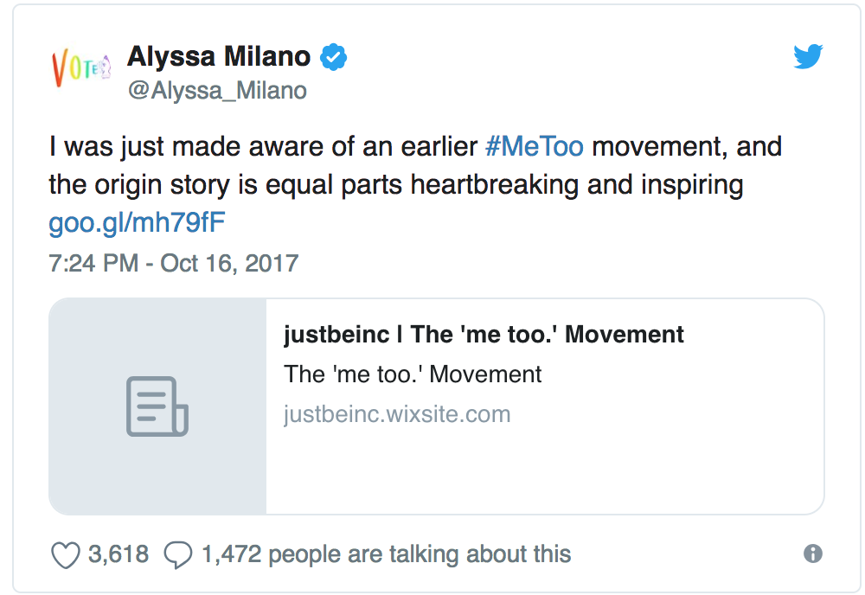
What is #metoo?

Slide 6
About the Data
Data: FiveThirtyEight Survey
Questions: Likert Type
How often would you say you: (Often, Sometimes, etc.)
Cry
Watch Sports
Express physical affection to male friends, like hugging, rubbing shoulders
In general, how masculine or ’manly’ do you feel?
Very masculine
Somewhat masculine
Not very masculine
Not at all masculine
No answer

Slide 7
About the data
Questions: “Select all that Apply” type
Have you seen or heard of a sexual harassment incident at you work? If so, how did you respond?
Confronted the accused person
Contacted HR
Contacted the manager
Reached out to the victim to offer support
Did not respond at all
Never witnessed sexual harassment
Other

Slide 8

About the data
Encoding:
LabelEncoder( )
One hot encoding
1615 male participants
Demographic Info:
Race
Education
Sexual orientation
State
Notes:
Yes. 144
No 1442
No Answer 29

Slide 9
“Manhood is something that is hard to earn and easy to lose.”
Hidden Brain, SHANKAR VEDANTAM, Oct. 1, 2018

Slide 10
Explore the data

Slide 11
Explore the data
Notes:
327 →. 51% of respondents to this question,, who feel somewhat masculine -- read body language and DID NOT change
38 → 48% of respondents to this question,, who feel somewhat masculine --- read body language and changed their behavior
204 → 51% of respondents to this question,, who feel somewhat masculine ask for consent –
___________________________________________________________________________________
When you want to be physically intimate with someone, how do you gauge their interest?
Every situation is different. 59%–
–
Read their physical body language to see if they are interested. 46–
–
It isn’t always clear how to gauge someone’s interest. 35–
–
Ask for a verbal confirmation of consent. 31–
–
Make a physical move to see how they react. 29–
–
Other. 7

Slide 12
EXPLORE THE DATA
Notes:
Father 1109
Mother 655
Other family member 564
Pop Culture 303
Friends 559
Other 329

Slide 13
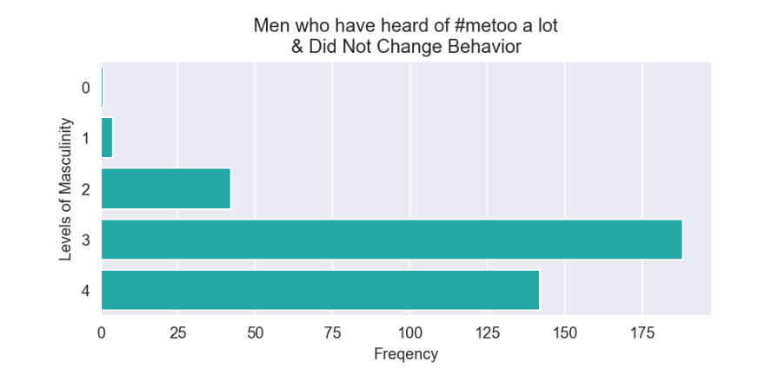
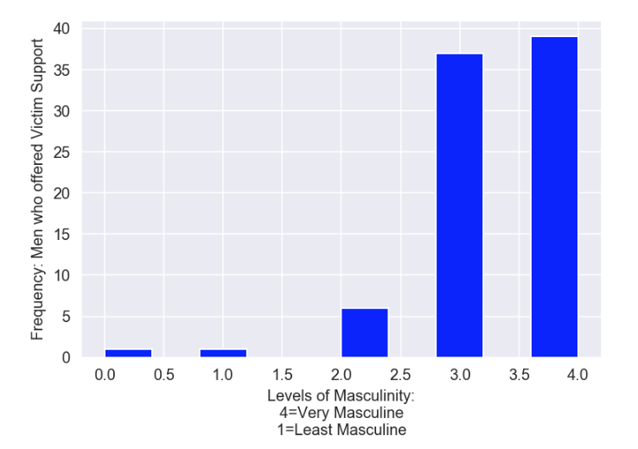
Exploring the data
Men’s response to witnessing sexual assault or harassment at work.
Who helps out?

Slide 14
Model
Goal:
Predict to two classes
Interpretability
Logistic Regression
Allow quantification of a one unit increase in a feature.
How much do features have an impact on the prediction?
Notes:
Yes. 144
No 1442
No Answer 29

Slide 15
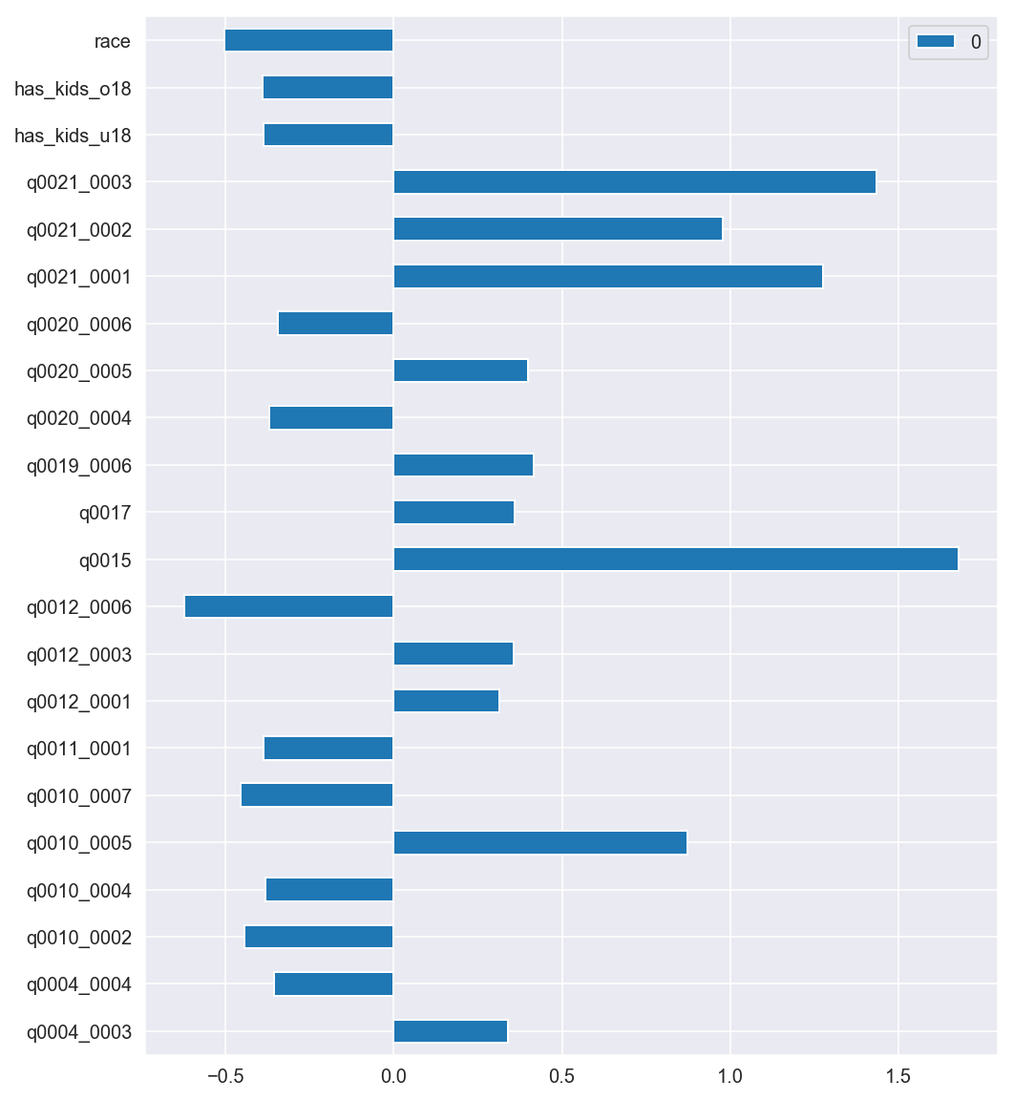
Impact (associations)
Logistic Regression: beta coefficients
Over the past 12 months, when it comes to sexual boundaries, which of the following have you done?
Q21.3:
asked if went to far during sex
Q21.2:
talked w/ friends about whether you pushed a partner too far
Q21.1:
Wondered whether you pushed a partner too far
Q12.6:
If you have seen or heard of harassment at work, how did you respond?
Never witnessed sexual harassment
Q15:
Do you think about your behavior at work differently in the wake of #MeToo

Slide 16
findings
Confusion Matrix
Classification Metrics:
Sensitivity: .545
Specificity: .991
Precision: .66
Accuracy: .918
True Negatives: 1459 | False Positives: (Predicted = Yes, Actual = No) 12
False Negatives: (Predicted = No, Act. = Yes) 20 | True Positives: 24
Notes:
SensitivityRecall = correctly identifying the target group
Specificity = correctly identifying the negative class
Precision = the percent of relevant predictions
Accuracy = measure of the explained variance

Slide 17
9% of men changed their behavior
Results

Slide 18
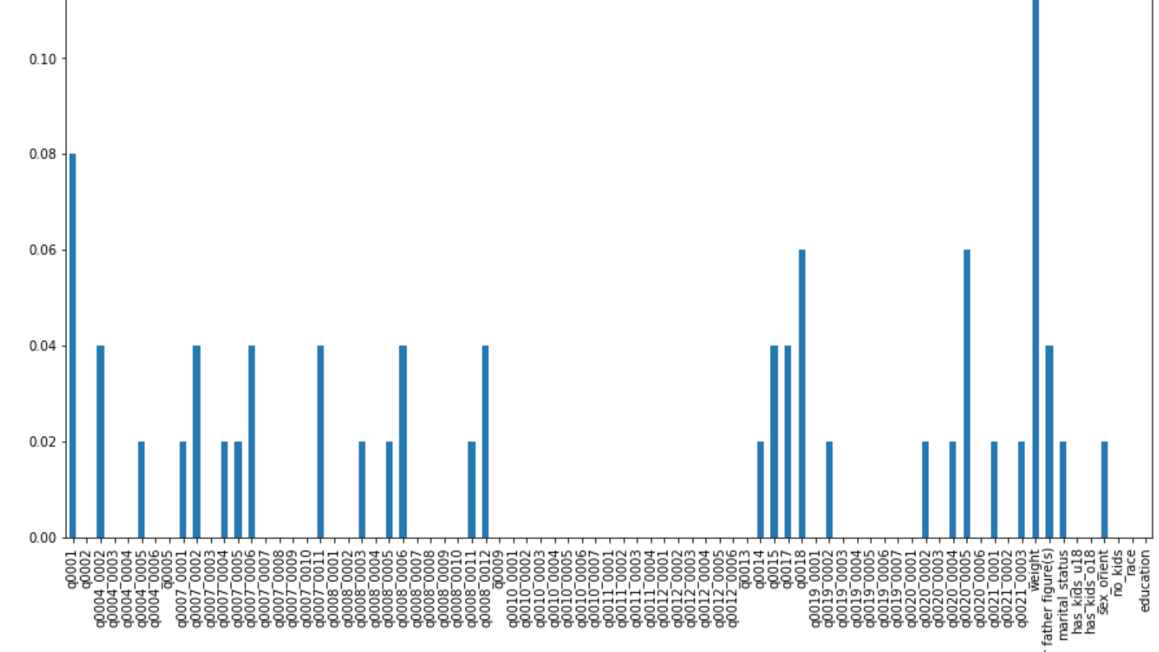
Next steps
WHO?: Explore demographic relationships
What is really different between the two groups?
Dive into the most predictive features:
Check for statistical significance
Get confidence intervals
ROC
Feature Importances

Slide 19
References
'Man Up': How A Fear Of Appearing Feminine Restricts Men, And Affects Us Allhttps://www.npr.org/templates/transcript/transcript.php?storyId=653339162
The New Norm: https://www.npr.org/programs/invisibilia/481887848/the-new-norm
What do Men Think it Means to be a Man: https://fivethirtyeight.com/features/what-do-men-think-it-means-to-be-a-man/

Slide 20
Questions?

Slide 21
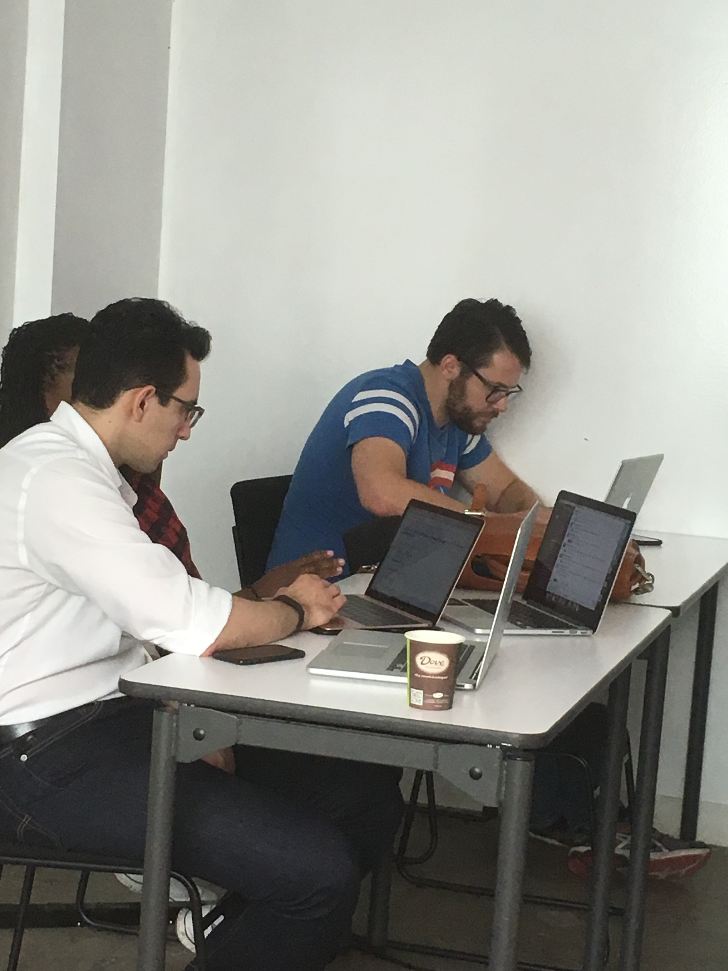
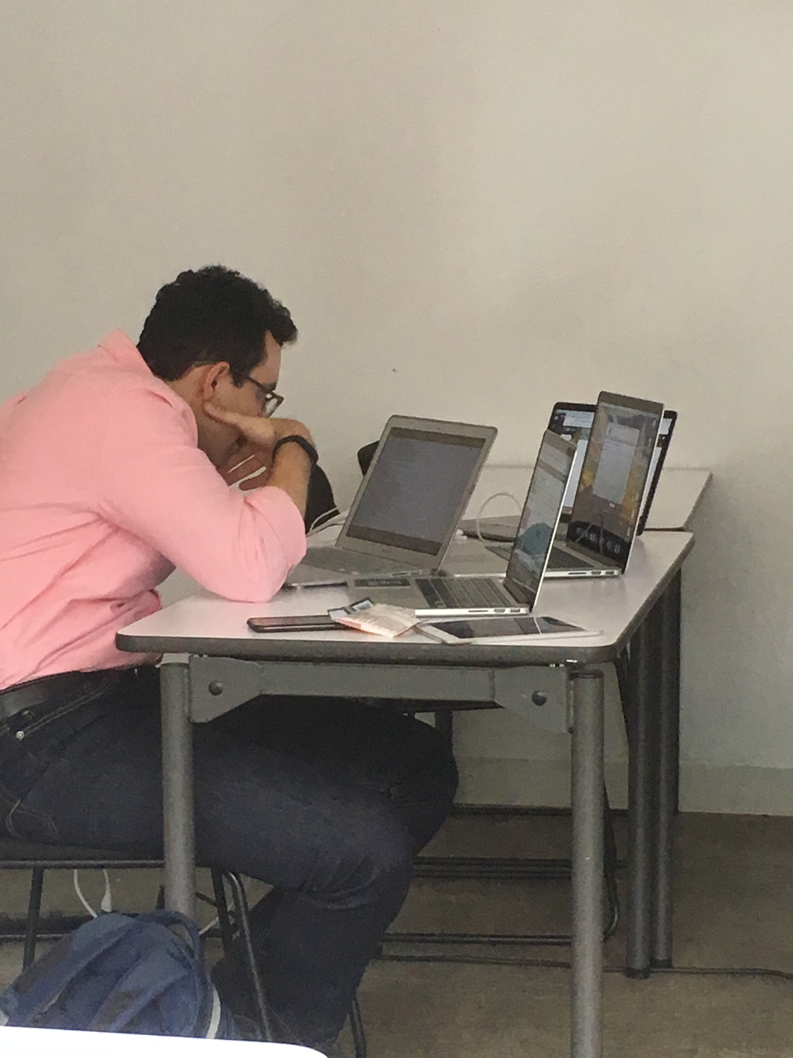
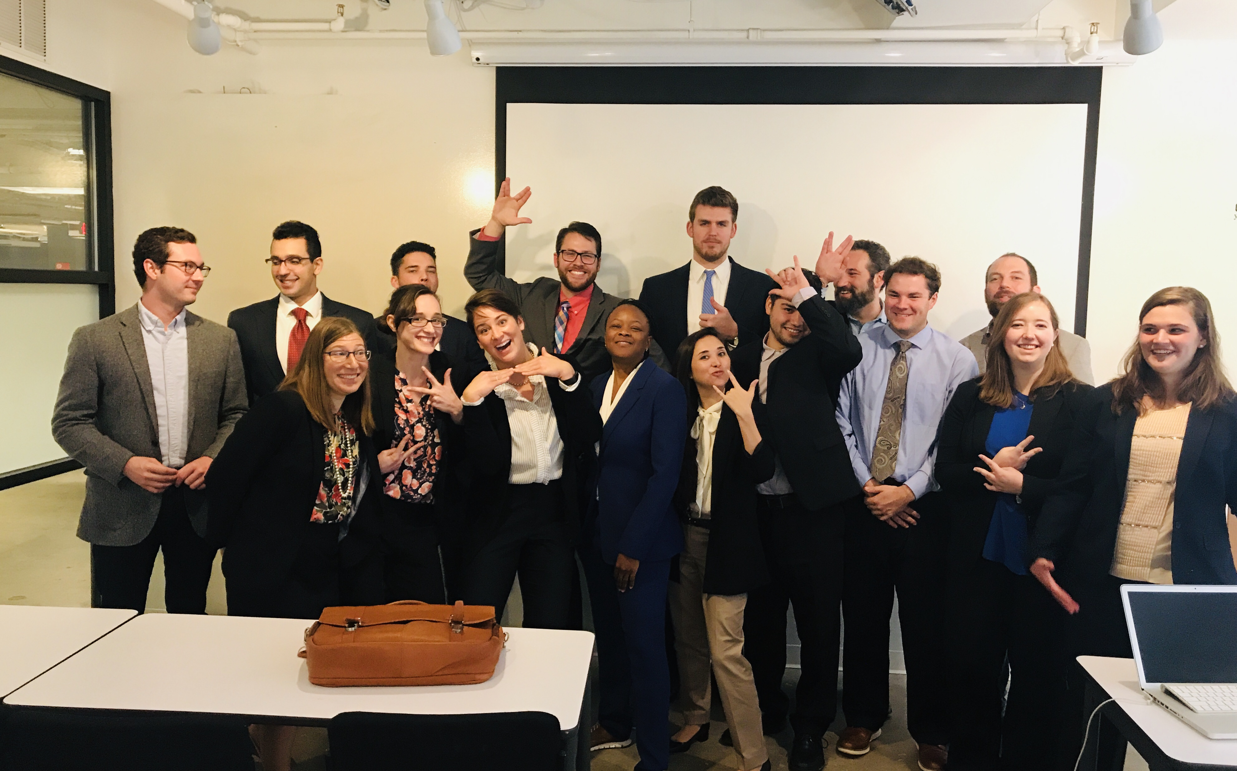
Thank You!

